Slide 1

Wednesday, August 29, 2012
TISK Problems:
If a scatter plot shows a strong negative correlation between weight (in pounds) and number of hours of TV watched per week, what recommendation might you make to someone who wanted to lose weight?
Find the constant difference of the sequence:
34, 4, 2, 4, 34, 164, …
Multiply: $\frac{3}{16}∙\frac{4}{21}$
We will have 3 Mental Math questions today.
Please do not use the whiteboards until instructed to do so.
Homework: Worksheet 2.6
Notes:
Mental Math
Start with a multiple of 6 between 80 and 90. Divide by 4. Subtract 18. (3)
Start with a multiple of 9 between 50 and 60. Divide by 3. Add 27. (45)
Start with a multiple of 11 between 110 and 130. Add 19. Divide by 5. Add 15. (43)

Slide 2
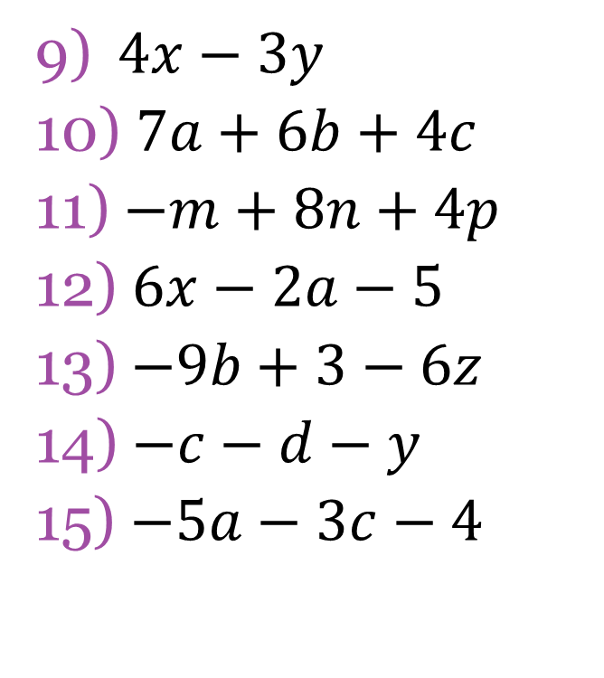
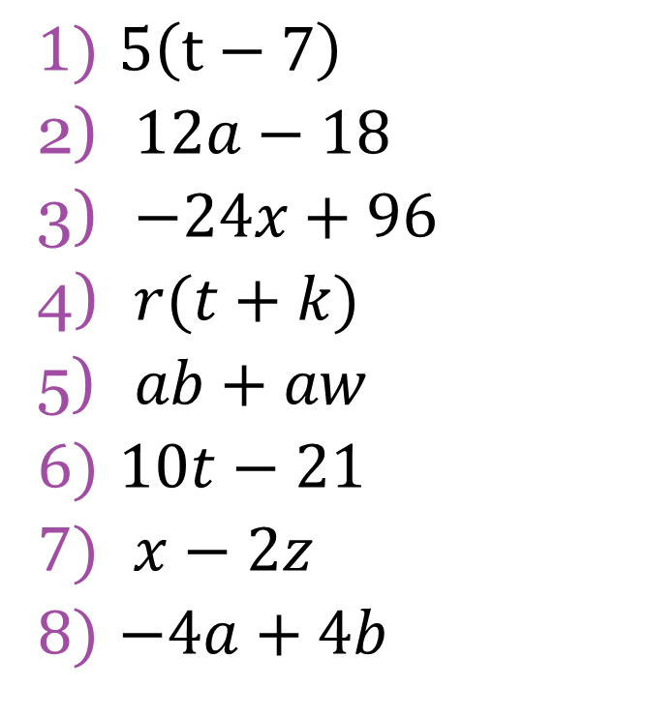
Homework Check
$5\left(t−7\right)$
$12a−18$
$−24x+96$
$r(t+k)$
$ab+aw$
$10t−21$
$x−2z$
$−4a+4b$
$4x−3y$
$7a+6b+4c$
$−m+8n+4p$
$6x−2a−5$
$−9b+3−6z$
$−c−d−y$
$−5a−3c−4$

Slide 3
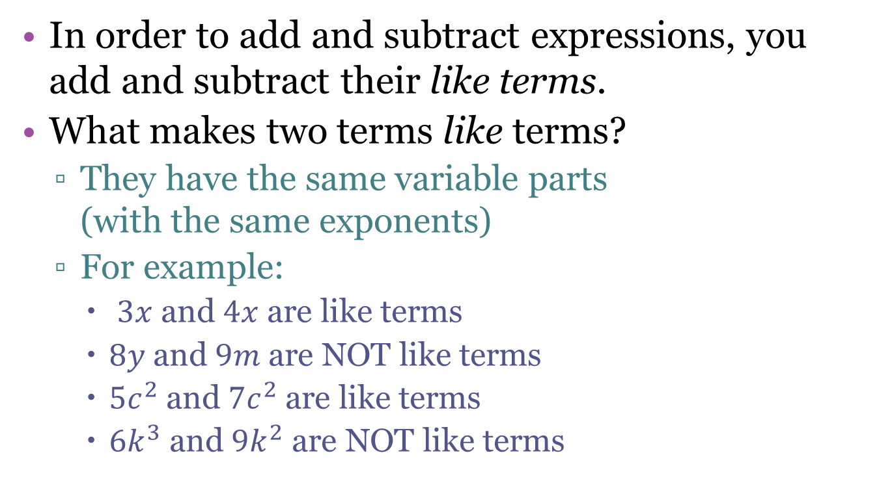
Adding and Subtracting Expressions
In order to add and subtract expressions, you add and subtract their like terms.
What makes two terms like terms?
  They have the same variable parts
  (with the same exponents)
  For example:
    $3x$ and $4x$ are like terms
    $8y$ and $9m$ are NOT like terms
    $5c^{2}$ and $7c^{2}$ are like terms
    $6k^{3}$ and $9k^{2}$ are NOT like terms

Slide 4




Simplifying Expressions
When you have like terms in an expression, you can simplify the expression by “combining like terms”.
To do so, you add the number parts of the like terms.
Simplify the expression:
$$7+11=18$$
$$7x+11x=18x$$
$$−5+(−9)=−14$$
$$18x+8y−14$$

Slide 5
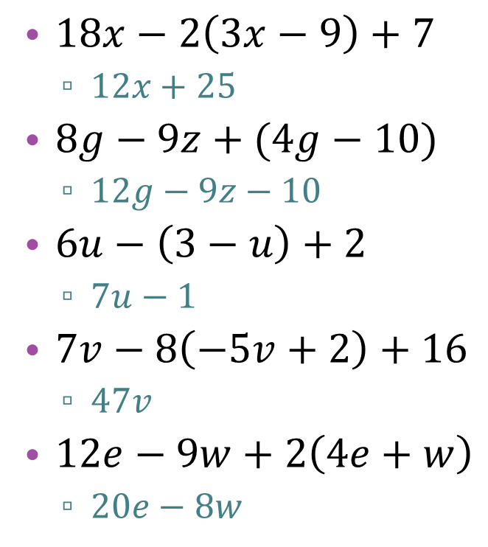
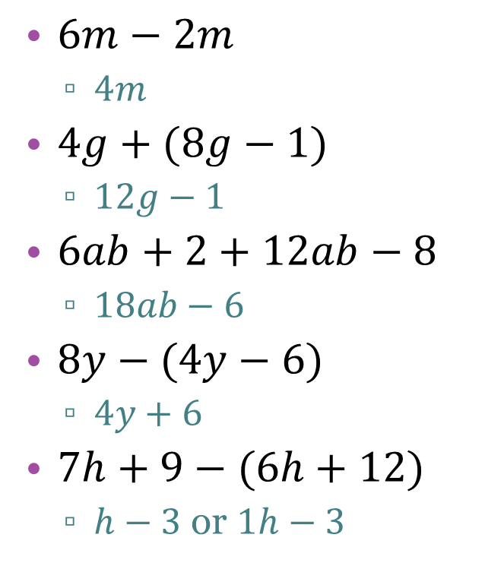
Practice adding & subtracting expressions
$6m−2m$
  $4m$
$4g+(8g−1)$
  $12g−1$
$6ab+2+12ab−8$
  $18ab−6$
$8y−(4y−6)$
  $4y+6$
$7h+9−(6h+12)$
  $h−3$ or $1h−3$
$18x−2\left(3x−9\right)+7$
  $12x+25$
$8g−9z+(4g−10)$
  $12g−9z−10$
$6u−\left(3−u\right)+2$
  $7u−1$
$7v−8\left(−5v+2\right)+16$
  $47v$
$12e−9w+2\left(4e+w\right)$
  $20e−8w$

